Slide 1
How VR Case Studies Influenced the Design of a Research Study: Building a Pilot Innovation on VR Program Management Strategies
Presenters:
Susan Foley, Bob Burns, John Halliday
Institute for Community Inclusion
U Mass Boston

Slide 2


The Rehabilitation Technical Assistance Center (RTAC) on VR Program Management
Charged with developing, piloting, testing, and disseminating a “VR program management model including elements of strategic planning, QA, and HR development”
Partnering with InfoUse
Funded by the U.S. Department of Education’s NIDRR
www.VR-RTAC.org

Slide 3
Why the Project Came to Be
Very little knowledge about what constitutes effective practices in HR, QA, and strategic planning.
How are these related to outcomes important to VR agencies, RSA, and stakeholders like clients, employers, taxpayers, legislators.
There may be models out there from other sectors, industries that could be applied to VR

Slide 4
Literature Reviews and Experts
QA, HR, and Strategic Planning literature reviews were not providing the guidance on how to build a VR Program Management Model;
Experts had great ideas, but not sure of the applicability within VR agencies
Should we use an existing model, like the Baldrige?

Slide 5
Case Studies
We went to the source… what happens in VR agencies regarded as well-managed?
Nomination process through Advisory Group (majority VR directors), RSA, TACE’s.
Some nominated because of a specific effort in QA, SP, and/or HR.

Slide 6
Text Description of next eight slides
Each of the 8 state VR agencies is listed with a picture on the left. UT: honeybee hive, TX General: Mexican fruit bat, TX Blind: cowboy boots, FL General: Panther, VT: Maple Syrup; WV: Black Bear; MD: Women’s lacrosse; CO: Butterfly

Slide 7

Utah
Executive Director, Don Uchida
State Motto: Industry

Slide 8
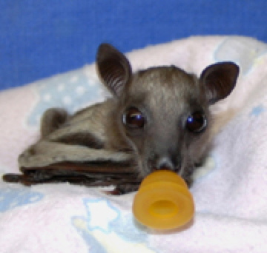
Texas
Assistant Commissioner, Jim Hanophy
Mexican Fruit Bat from the Congress Street Bridge, Austin
State Motto: Friendship

Slide 9

Texas Blind
Assistant Commissioner, Barbara Madrigal
The official state footwear is the cowboy boot.

Slide 10

Florida
Director: Bill Palmer (retiring)
Director, Aleisa McKinley
Florida Mammal is the Panther
State Motto: In God We Trust

Slide 11
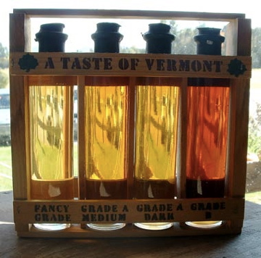
Vermont
Director: Diane Dalmasse
Maple is the State Flavor!
State Motto: Freedom and Unity

Slide 12
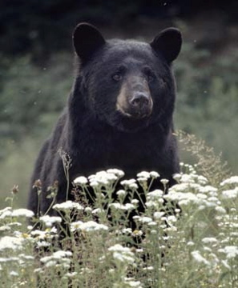
West Virginia
Director, Deborah Lovely
State Motto: Mountaineers are always free
State Mammal is the Black Bear

Slide 13
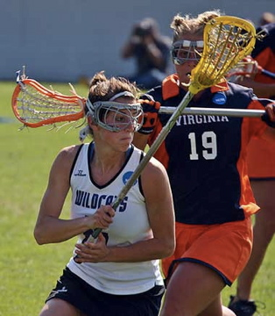
Maryland
Assistant State Superintendent Suzanne Page
State Motto: Manly deeds womanly words
State team sport is lacrosse

Slide 14

Colorado
Director, Nancy Smith
State Motto: Nothing without the deity
State insect is the Colorado Hairstreak Butterfly

Slide 15
What did we do?
Reviewed reports and data provided
Interviewed Senior Management and Field Services Personnel
From June 2011 to September 2011
Teams of 3 to 4
At least one research staff member and at least one former VR director or senior manager on the team

Slide 16
Text description of next slide
Slide is a depiction of the elements of a management model depicted with outcomes at the center. The elements include: leadership, customers, mission/strategic planning, data/QA/metrics, communication, workforce, services and processes,

Slide 17
VR Performance Management Framework
Communication
Mission & SP
Leadership
Customers
Outcomes
Data, QA & Metrics
Workforce
Service & Processes

Slide 18
Leadership in Action
Action orientation
Nimble, flexible, experimenters
Actively promoting and maintaining a good reputation with external partners and parties.
Varying degrees of access to and interaction with legislators to influence policy and budget

Slide 19
Leadership
A theme of: Leadership being a support to implementation with a “serve and support” “inverted pyramid” “HR emphasis”
Workforce development with a focus on leadership
Concentration on building an effective workforce and identifying and talent both internal and external

Slide 20
Customers
Clear message about the primary customer.
A responsive customer friendly approach spread throughout.
Management/Leadership regarded their own front line staff as its most important internal customer.

Slide 21
Mission and Strategic Planning
Mission is central, constant, and clear.
Strategic planning is valued if it helps agencies remain on mission, be adaptive, flexible, and able to “reboot” given the highly changeable, political nature of state government.
Notion of “contingency” planning rather than long-range linear strategic planning.

Slide 22
HR and Workforce
Strong focus on leadership at every level. All staff are leaders.
“Inverted Pyramid” approach. Management supports direct services.
Emphasis on staff development and building skills in problem solving
Retention and succession planning efforts

Slide 23
Services and Processes
Strong interest in making things work better. Such as invoicing, on-boarding of staff/CRPs, HR functions, IT functions.
Increasing skill in conducting process improvement efforts.

Slide 24
Data, QA, Metrics
Quality improvement with a link between QA, use of data, and staff training
Quite a few had very sophisticated internal program evaluators
Data driven leadership
Promoting high expectations both internally and externally
Clearly articulated goals but few in number.

Slide 25
Communications
Formal efforts to create work groups to identify improvements, make suggestions and create communication beyond hierarchies and official channels
Actively seeking formal and informal efforts to have information flow up, down, sideways, and throughout agency.

Slide 26
Questions?
Findings that we presented… are these consistent with people’s own experiences? Different issues?
Does this framework work??? Is it inclusive enough and does it have enough detail??
Other thoughts?

Slide 27
VR Performance Management Framework
Communication
Mission & SP
Leadership
Customers
Outcomes
Data, QA & Metrics
Workforce
Service & Processes

Slide 28
What do we mean by Framework?
A frameworks was more about the whole and less about the parts.
How do these components provide information to leaders and managers?
The question was not about how to implement any given technique (such as case file review) but how do leaders integrate the seven components to achieve outcomes.

Slide 29
Moving to a business case study approach
What are the best ways to achieve management outcomes or improvements by mastering the use of these components?

Slide 30
Examples of Management Outcomes and Improvements
Performance Management:
  Vendor Performance
  Capacity Building
Workforce Development
  Staff leadership development
  Recruitment
  Growing supervisors and new leaders

Slide 31
Text description for next slide
The next slide is a depiction of a “sound board”. Each of the elements of management (customers, outcomes, leadership, etc) have a lever that goes from high to low. For any given issue, the 8 elements may be high, medium, low.

Slide 32
VR Performance Management Framework
Leadership | Customers | Mission & S.P. | HR & Workforce | Services & Processes | Data, QA, Metrics | Communications | Outcomes
High
High
High
High
High
High
High
High
Low
Low
Low
Low
Low
Low
Low
Low

Slide 33
Features and Benefits
FEATURES
  Learning collaboratives
  Consultation
  Peer Process
  Structured rigorous process
  Self-assessment
BENEFITS
  Innovation
  Solutions
  New colleagues
  Learning by using critical skills
  Professional development opportunities
  Start-up potential and opportunity to pilot an idea/effort.

Slide 34
Next Phase
RFP release in late November for a 12 month learning collaborative laboratory. 50K per VR Agency: up to 6 state VR agencies
4 in-person meetings per year, on-site TA, webinar, telephone and email TA.
Wrap around research and evaluation embedded in activities.

Slide 35
Thank You!!!
Contact information
Susan Foley, PhD
Susan.foley@umb.edu
617.287.4317

